Slide 1








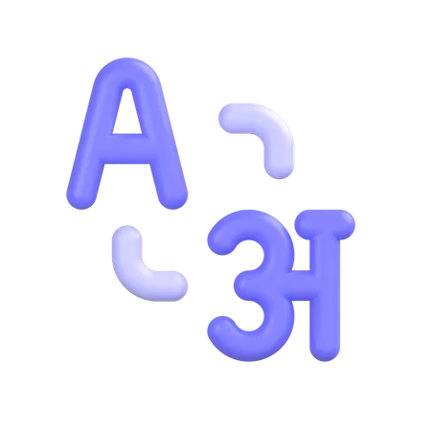

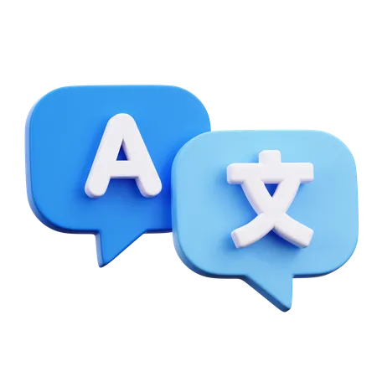

Language Master
LEARN ANYWHERE!
X47121
WESAM ABADI

Slide 2



Challenges
Hard to track progress
Losing motivation
Lack of resources.
Notes:
From the beginning and through the entire project scope I had some key points in mind to tackle, which are the challenges that face the average language learner, main challenges are: Loss of motivation: Language learners often encounter periods of reduced enthusiasm, resulting in diminished interaction with course materials or abandonment of their language pursuits altogether.
Progress tracking difficulties: Traditional language learning approaches typically fail to offer real-time or granular progress tracking, hindering learners' abilities to gauge their advancements accurately.
Limited resources: Availability of holistic language learning materials remains sparse, leaving aspiring polyglots wanting for diversified formats and media options.

Slide 3



What’s Language master?
Main objectives
Create an interactive web-based platform for language learning.
Offer interactive lessons, quizzes, and real-time progress tracking.
Utilize a Database for smooth user experience!
Notes:
My aim with Language Master is to tackle these challenges by developing an interactive web-based platform focusing on three core principles:
simplicity, engagement, and accessibility. We want to empower learners with interactive lessons, quizzes, and real-time progress tracking through Firebase Realtime Database, ensuring a seamless user experience."

Slide 4



Dev stack
React.js
Firebase
Sass
Notes:
For the Language Master project, we utilized a robust tech stack centered around React.js for frontend development, backed by the powerful Firebase Realtime Database. Additionally, we employed SCSS for efficient styling.
Choosing this combination ensured reliability, maintainability, and a rich set of features for our platform.

Slide 5
Dev stack
flexibility, efficiency, and adaptability.
React.js
Component-based architecture simplifies the creation of reusable features.
Extensive community support enables continuous improvement
Notes:
"To bring this web application to life, I followed a comprehensive methodology. I employed [mention technologies, tools, and frameworks] to ensure the development process was efficient and effective."
"For the Language Master project, we utilized a robust tech stack centered around React.js for frontend development, backed by the powerful Firebase Realtime Database. Additionally, we employed SCSS for efficient styling and relied on GitHub for version control. Choosing this combination ensured reliability, maintainability, and a rich set of features for our platform."

Slide 6
Dev stack
Preferred due to its real-time synchronization capability.
Firebase
Fast data updates facilitate accurate progress tracking.
Built-in security features protect sensitive user data.
Notes:
"To bring this web application to life, I followed a comprehensive methodology. I employed [mention technologies, tools, and frameworks] to ensure the development process was efficient and effective."
"For the Language Master project, we utilized a robust tech stack centered around React.js for frontend development, backed by the powerful Firebase Realtime Database. Additionally, we employed SCSS for efficient styling and relied on GitHub for version control. Choosing this combination ensured reliability, maintainability, and a rich set of features for our platform."

Slide 7
Dev stack
Employed for improved readability and maintainability.
sass
Streamlined styles positively affect the appearance and usability of the interface.
Supports variables, nesting, mixins, and functions for more organized styling.
Notes:
"To bring this web application to life, I followed a comprehensive methodology. I employed [mention technologies, tools, and frameworks] to ensure the development process was efficient and effective."
"For the Language Master project, we utilized a robust tech stack centered around React.js for frontend development, backed by the powerful Firebase Realtime Database. Additionally, we employed SCSS for efficient styling and relied on GitHub for version control. Choosing this combination ensured reliability, maintainability, and a rich set of features for our platform."

Slide 8




Features
Gamified elements
Instant
Feedback
AI assistants
personal path
Notes:
Despite careful planning, the development process did pose some technical challenges. I encountered [briefly mention challenges] and overcame them through [briefly mention solutions].
"Let me introduce some standout features of Language Master. Gamified elements like badges, points, and leaderboards increase motivation and engagement. Autonomous learning paths allow users to choose their learning style and pace. Instant feedback mechanisms help identify strengths and weaknesses immediately. Furthermore, we incorporate multimodal learning resources, enabling text, audio, and video content. Plus, crowdsourced content integration extends our reach beyond traditionally taught languages. And finally, AI chatbots and machine translations enable better understanding and practice."

Slide 9
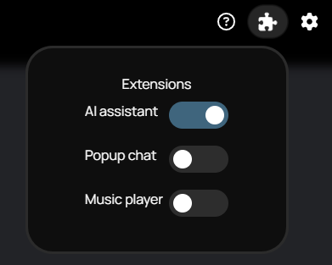
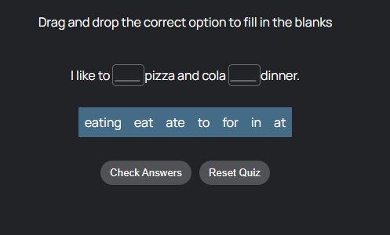
Features
Gamified experience
Notes:
Game like app, game lessons, points system, music
Animation all across the app

Slide 10
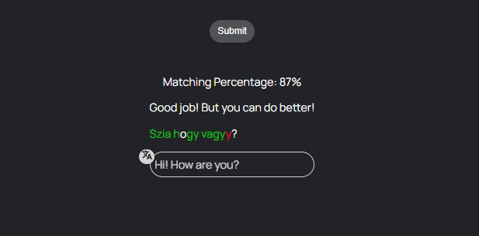
Features
Feedback
Notes:
The user should know and learn
Clear highlighting
Translation
Xp after each lesson

Slide 11
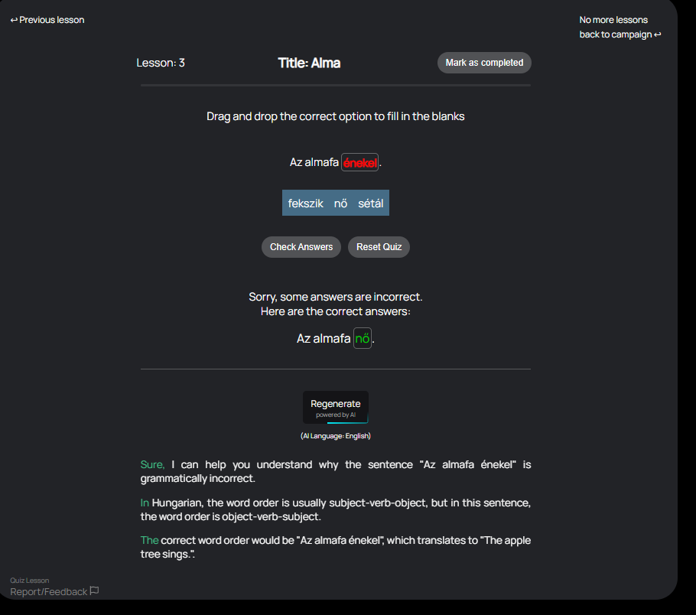
Features
AI
Notes:
AI is the key
Even if you know you made a mistake, how and why?
Unlimited explanations

Slide 12
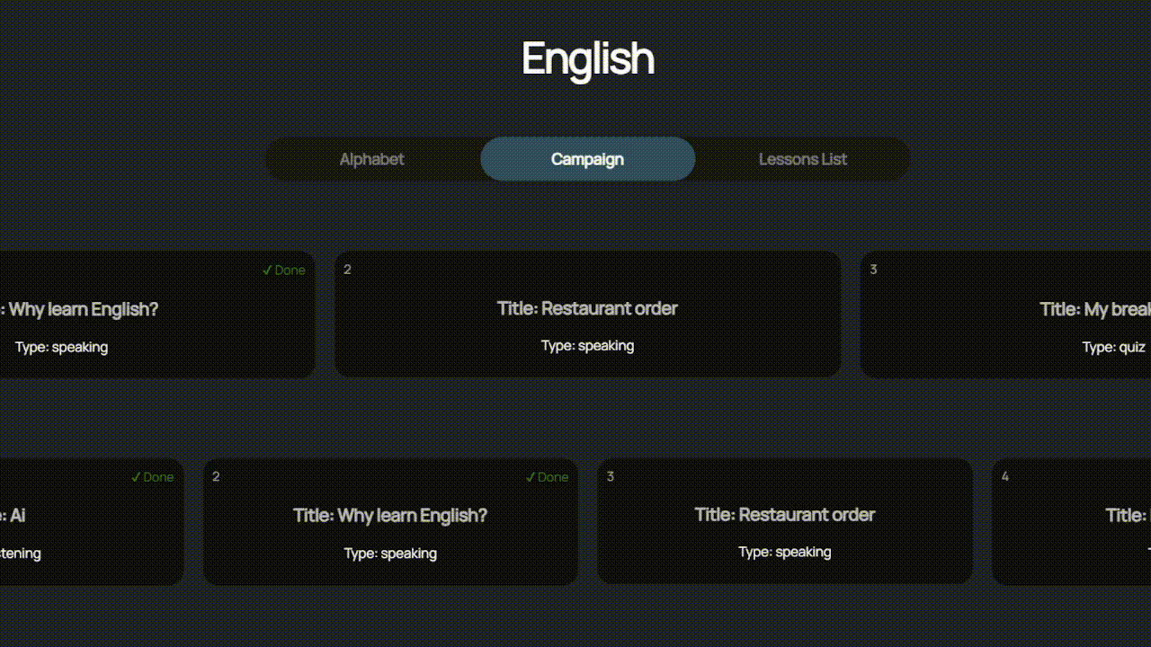
Features
Custom
path
Notes:
Chose your own path
Camphaing would provide a graduall increase in dificulyu
Free to do anything and revisit old lessons

Slide 13
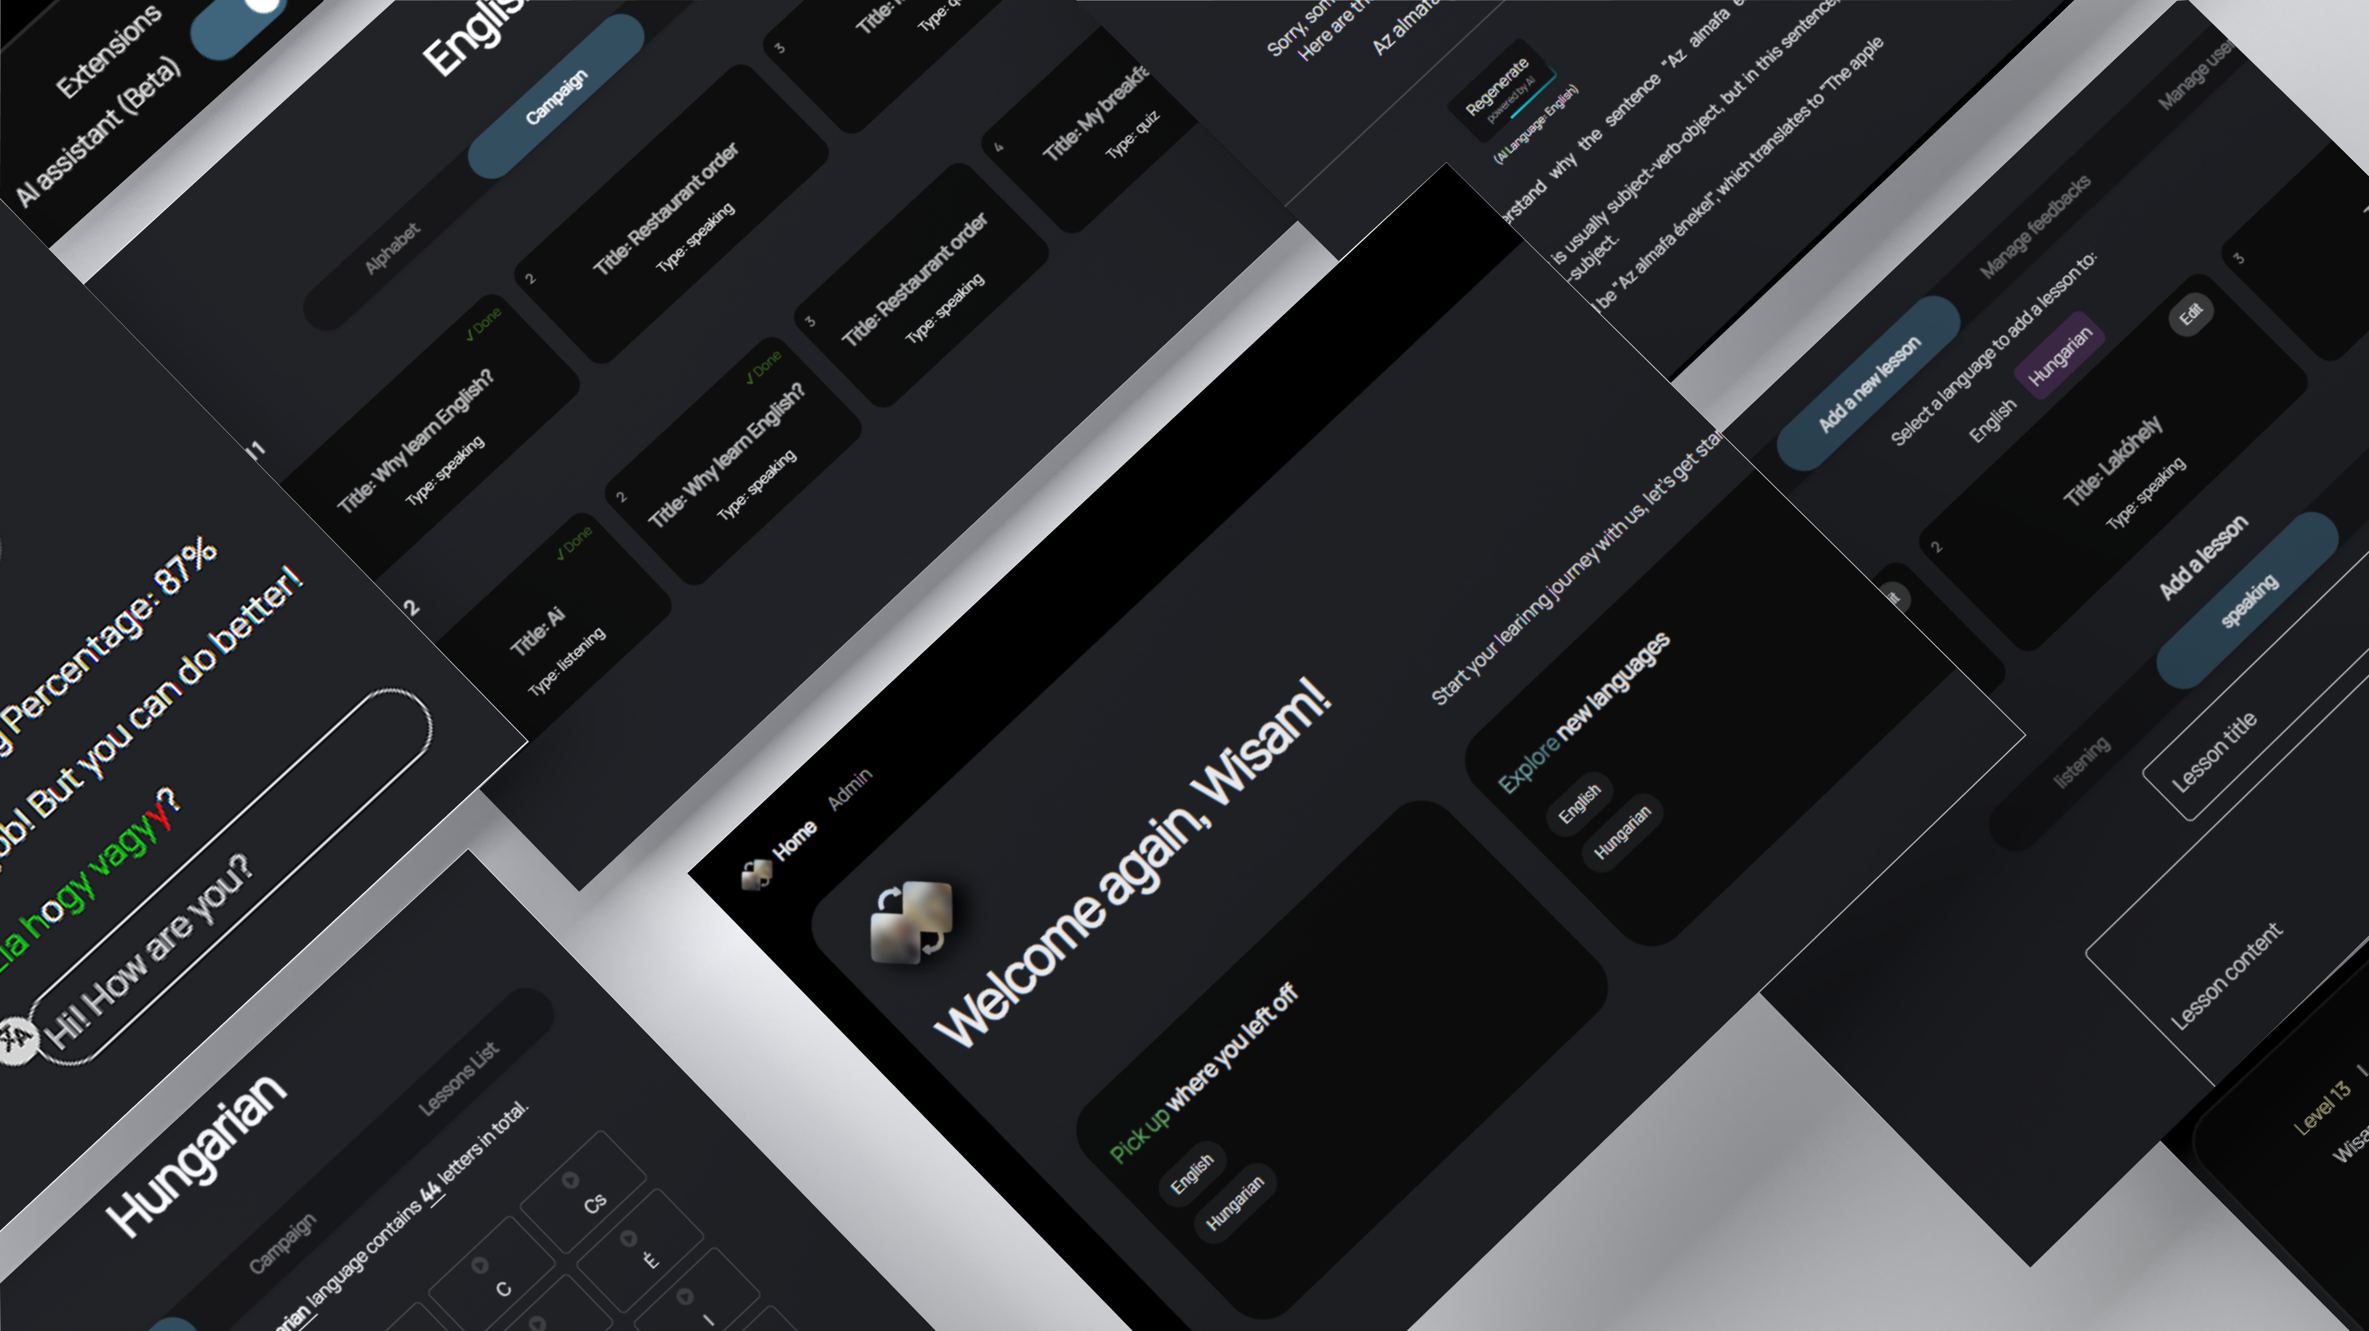
Notes:
An intuitive and visually appealing user interface is key to the success of any web application.
Here are some snapshots of the user interface, highlighting the design principles that guide the user experience.
You'll see our homepage, Admin, lessons page, quizzes page, profile page, and admin panel. Each element reflects our commitment to designing an accessible and straightforward platform catering to a variety of users."

Slide 14
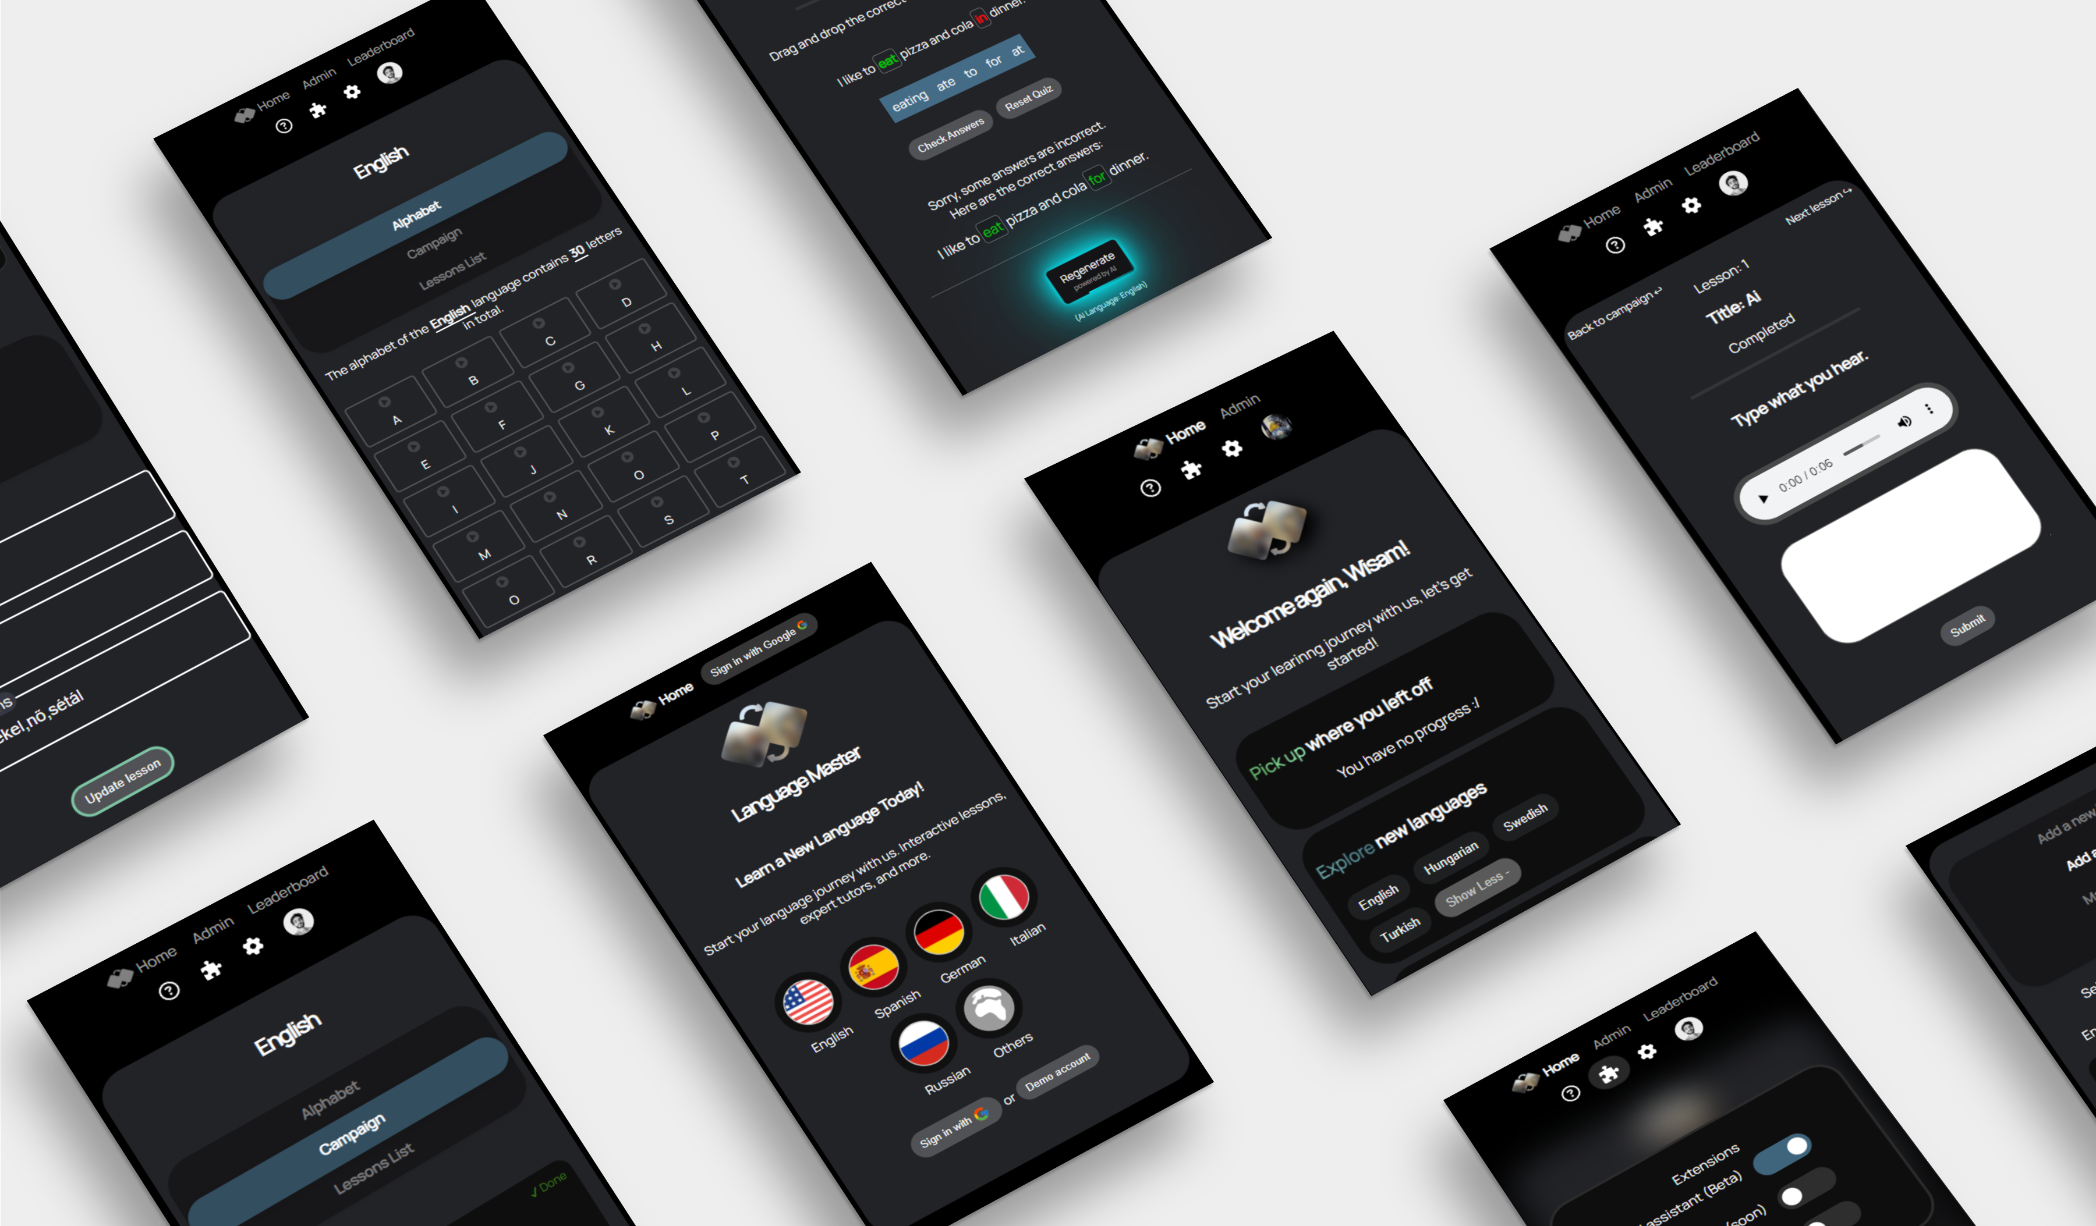
Notes:
These days it’s mobile first
The app should work on all browsers and screen sizes

Slide 15
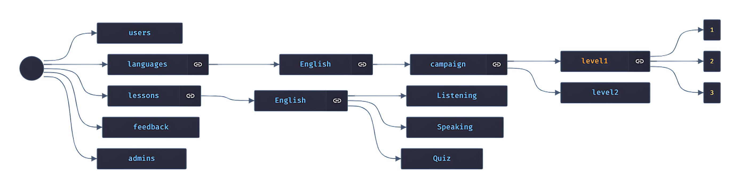
Firebase all the way!
Notes:
Backbone
Serves as backedn, DB and hosting

Slide 16
Json DB structure
Notes:
Json means seamless integration with js
Collections and docs
Low resources needed
->Client side app

Slide 17
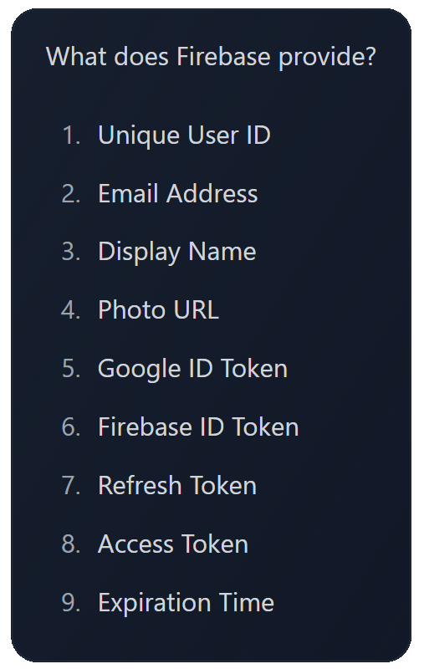





authentication
Notes:
No time wasted on reating profiles
Debugging info for admin

Slide 18
Hosting
Language.wesamabadi.com
Notes:
As they provide hosting, I don’t need to worry about a server
I can easily point my dns to their server.

Slide 19


THANKS!
Does anyone have any questions?
Notes:
As we look to the future, there are opportunities for further enhancement and expansion of the web application. I invite any questions you may have at this time. Thank you for your attention.

